Slide 1
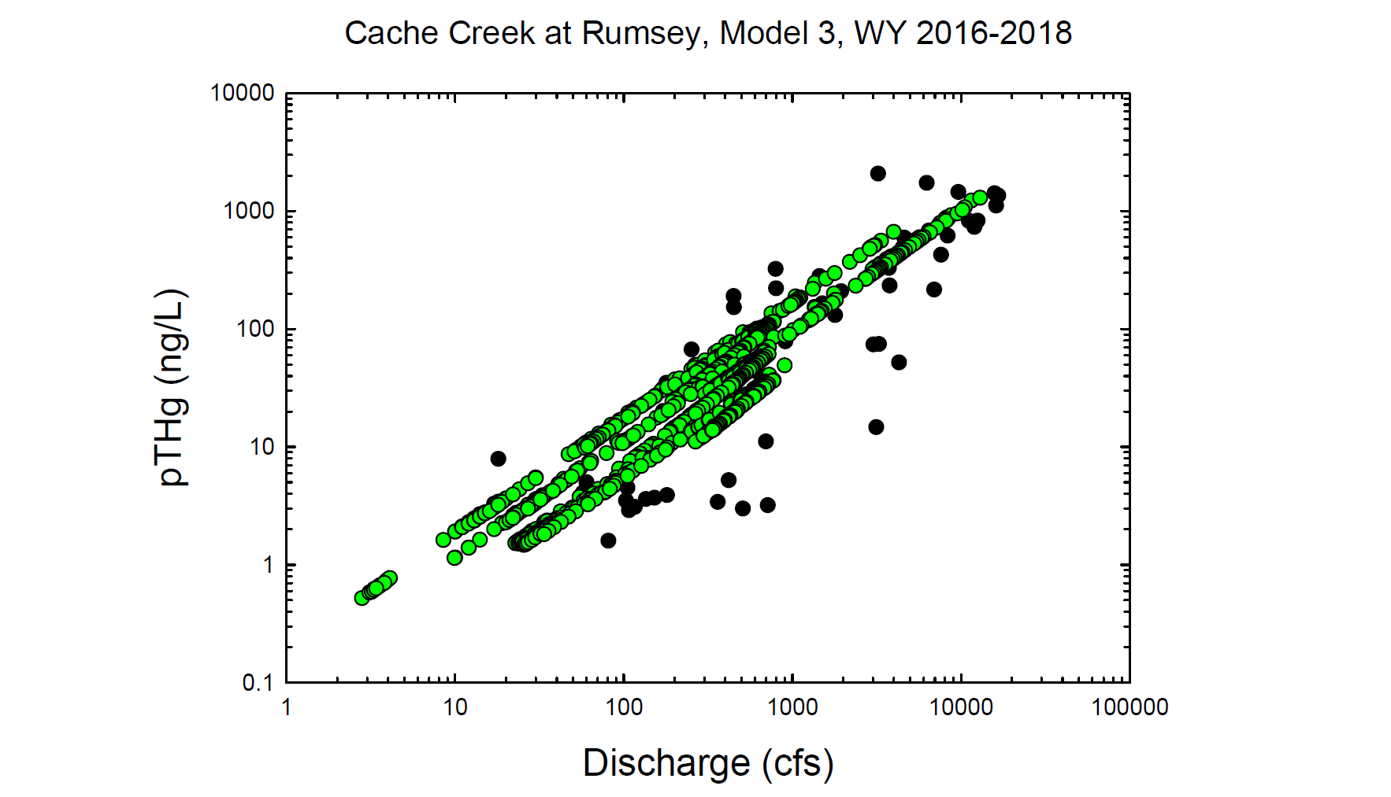
Black circles = Observed values
Green circles = Modeled values

Slide 2
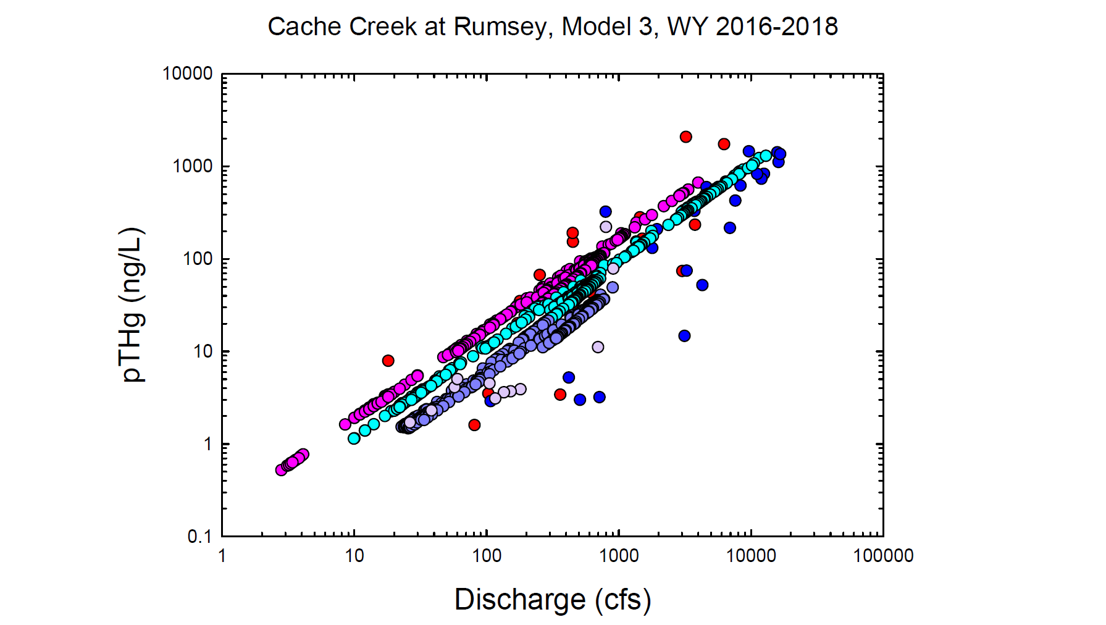
Red = Observed wy2016
Dk. Blue = Observed wy2017
Lt. Purple = Observed wy2018
Pink = Modeled wy2016
Lt. Blue = Modeled wy2017
Dk. Purple = Modeled wy2018

Slide 3
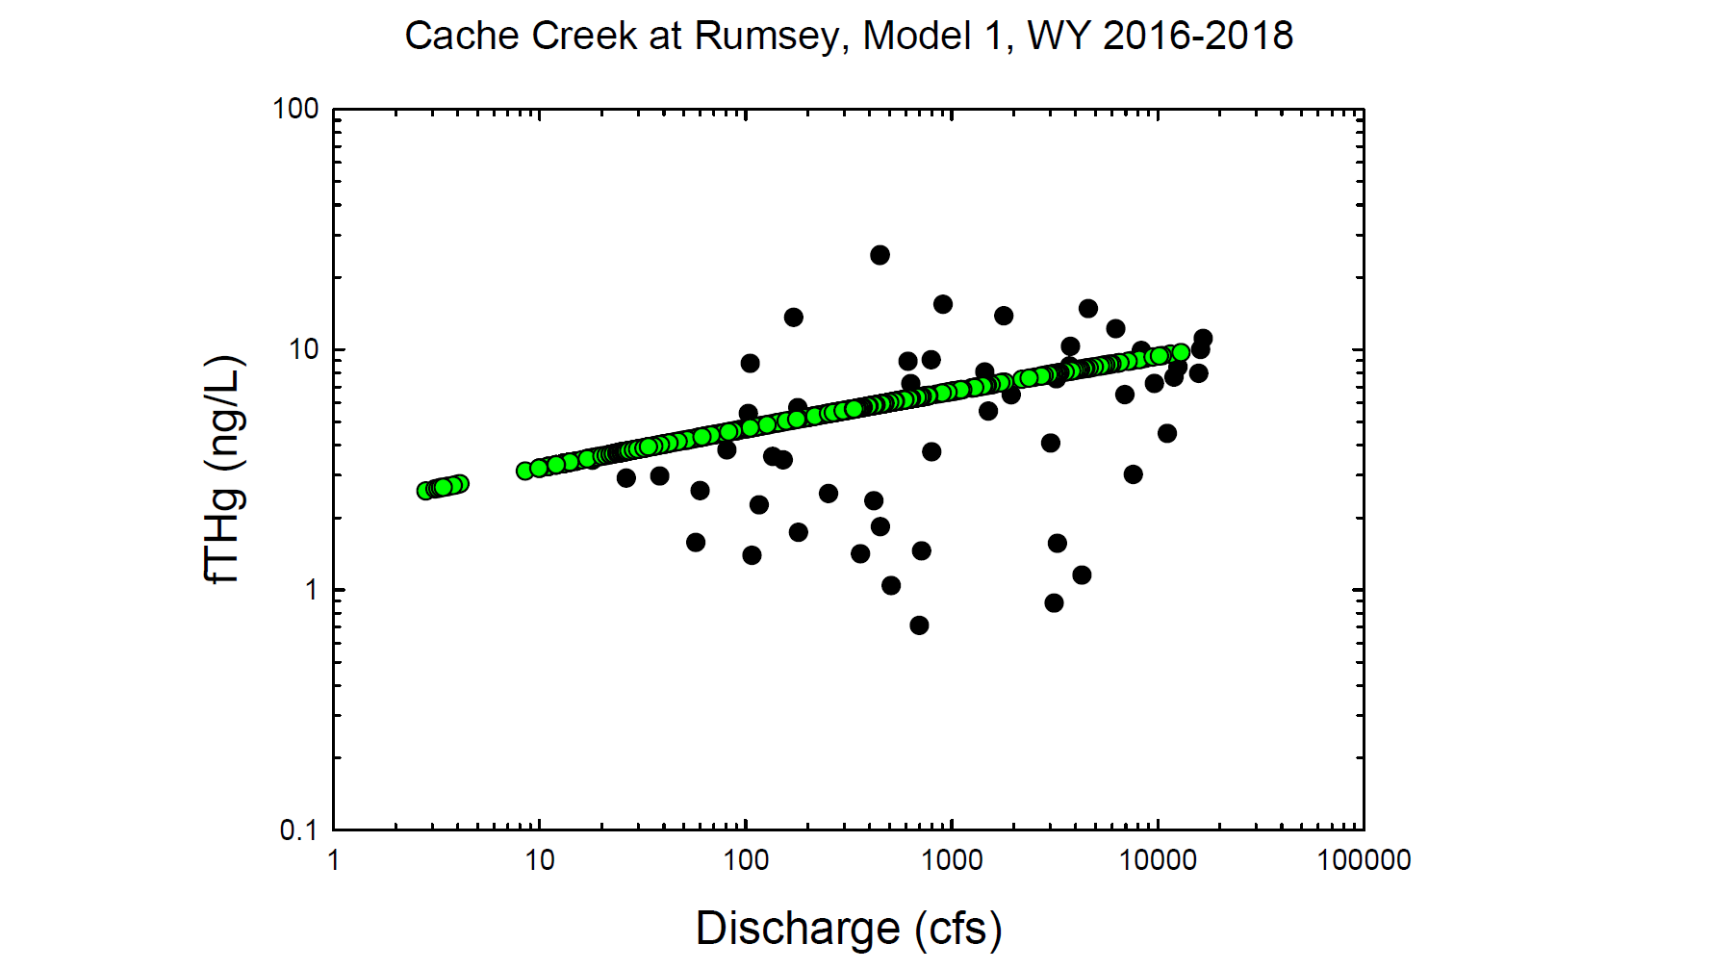
Black circles = Observed values
Green circles = Modeled values

Slide 4
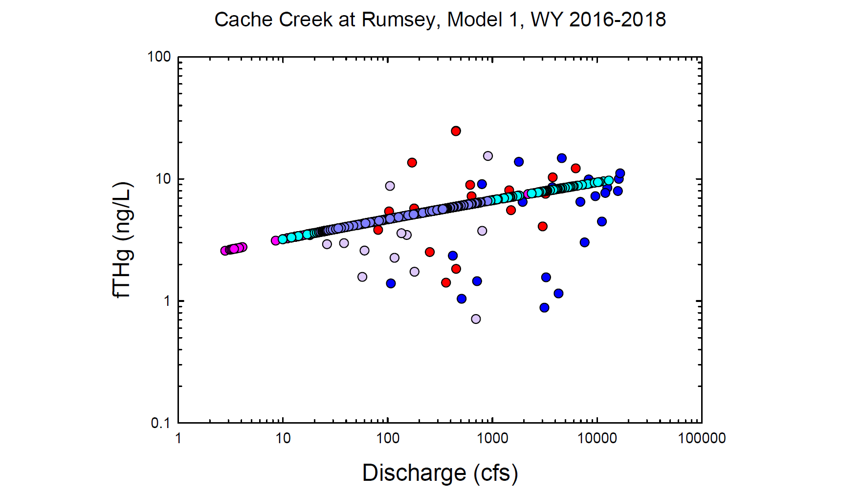
Red = Observed wy2016
Dk. Blue = Observed wy2017
Lt. Purple = Observed wy2018
Pink = Modeled wy2016
Lt. Blue = Modeled wy2017
Dk. Purple = Modeled wy2018

Slide 5
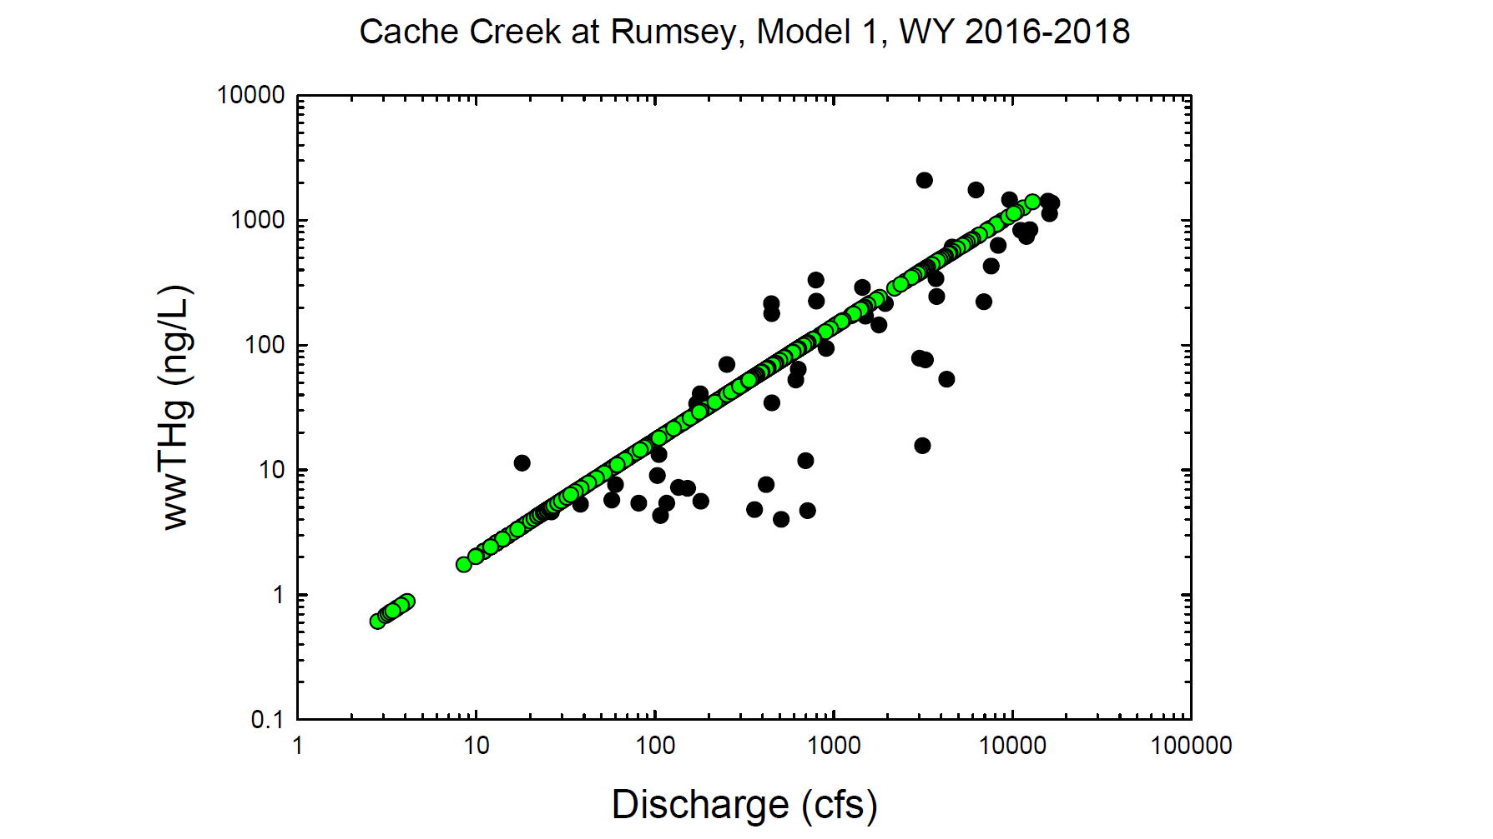
Black circles = Observed values
Green circles = Modeled values

Slide 6
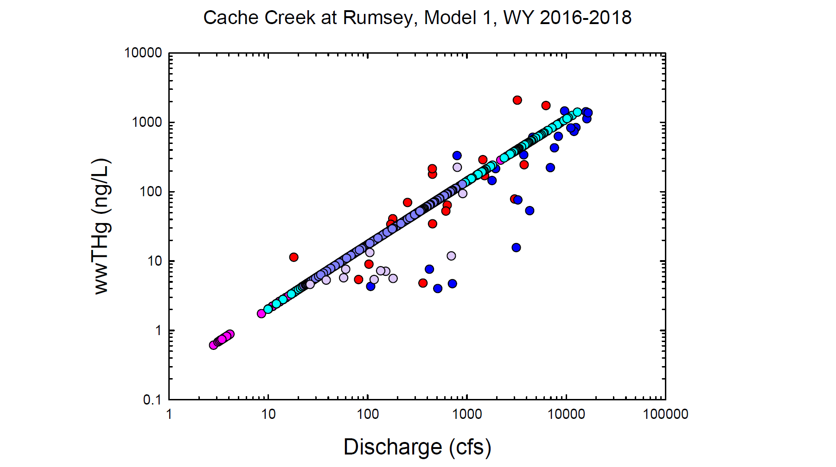
Red = Observed wy2016
Dk. Blue = Observed wy2017
Lt. Purple = Observed wy2018
Pink = Modeled wy2016
Lt. Blue = Modeled wy2017
Dk. Purple = Modeled wy2018

Slide 7
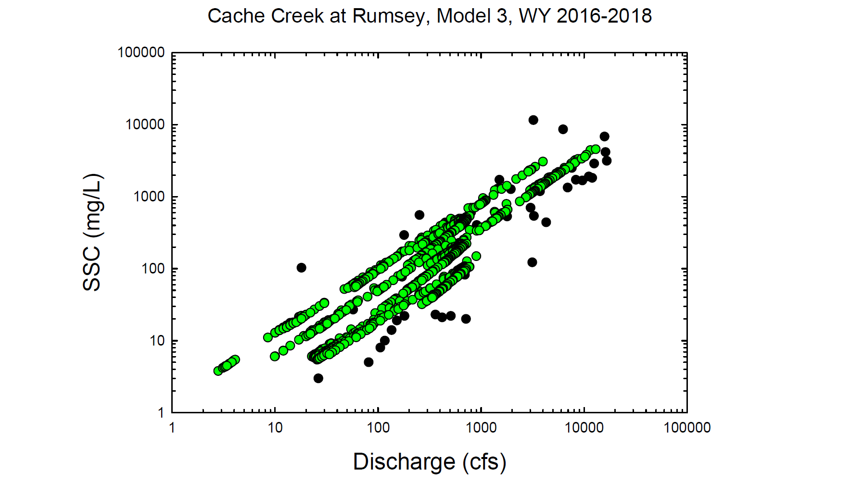
Black circles = Observed values
Green circles = Modeled values

Slide 8
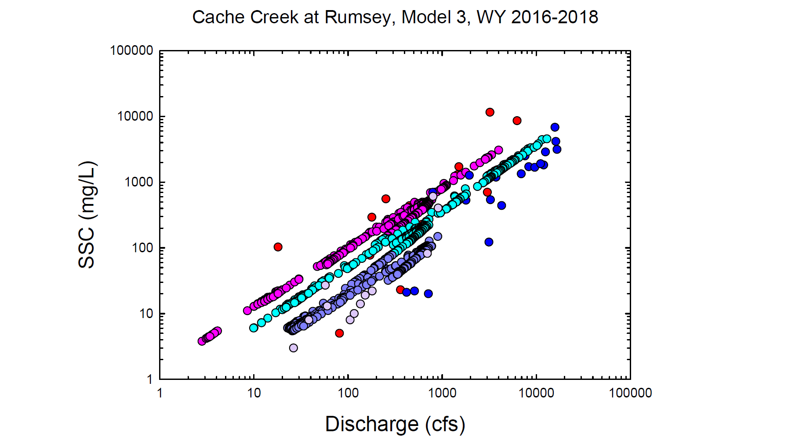
Red = Observed wy2016
Dk. Blue = Observed wy2017
Lt. Purple = Observed wy2018
Pink = Modeled wy2016
Lt. Blue = Modeled wy2017
Dk. Purple = Modeled wy2018

Slide 9
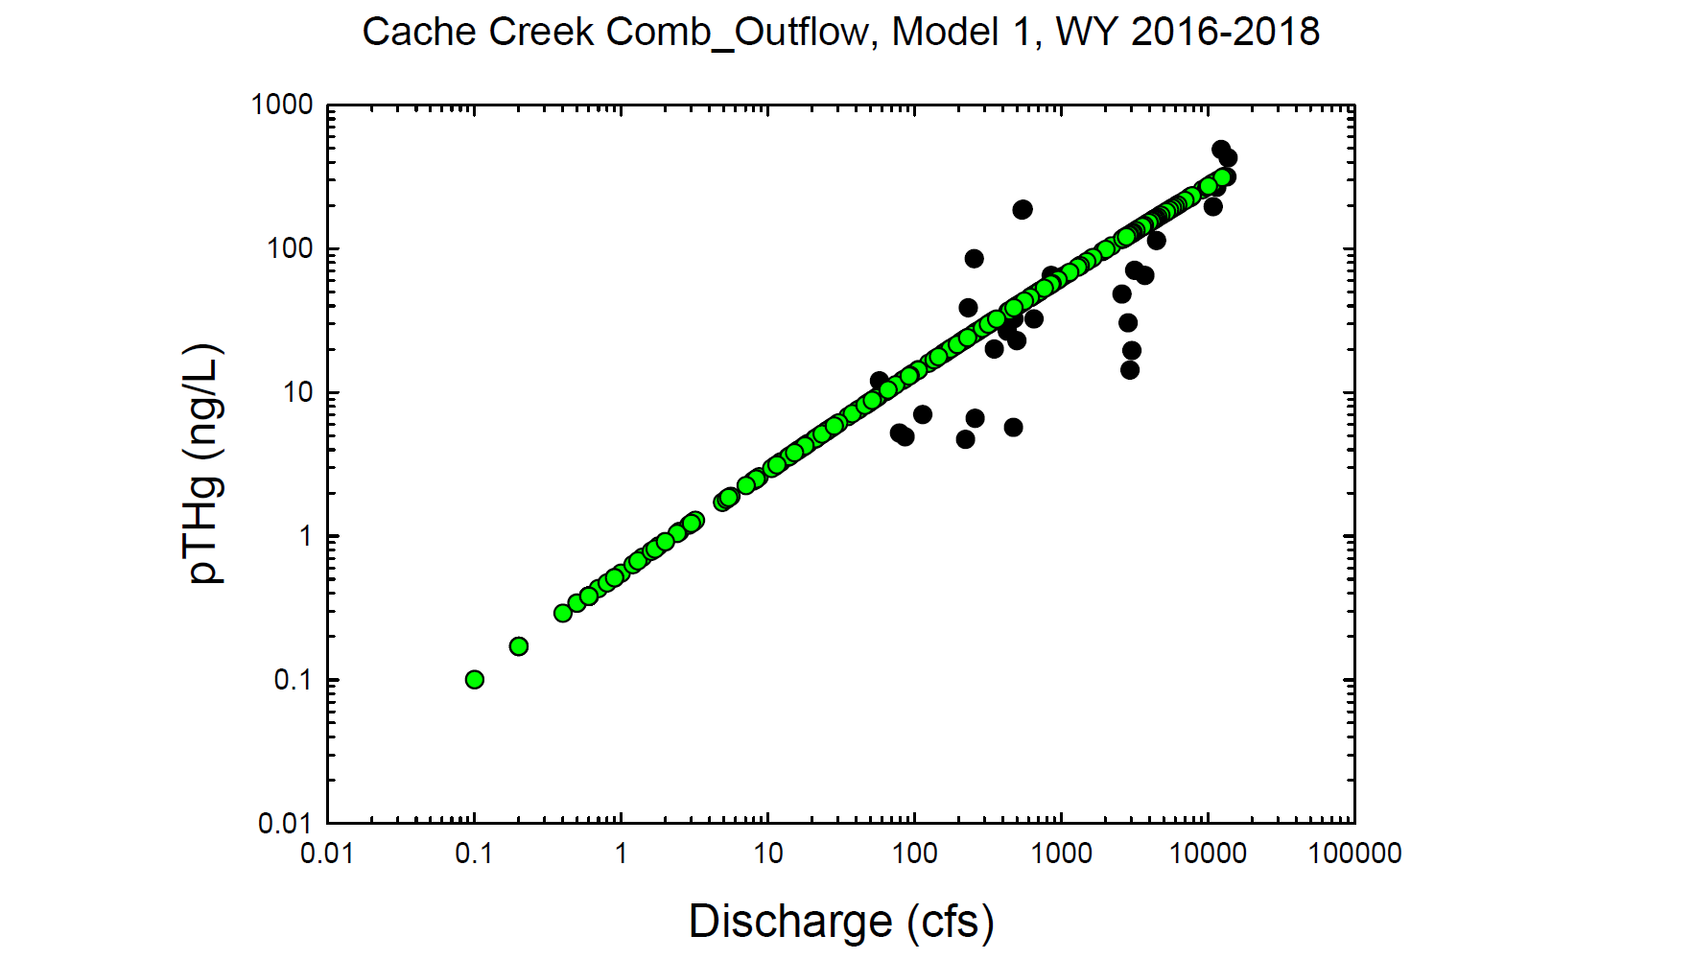
Black circles = Observed values
Green circles = Modeled values

Slide 10
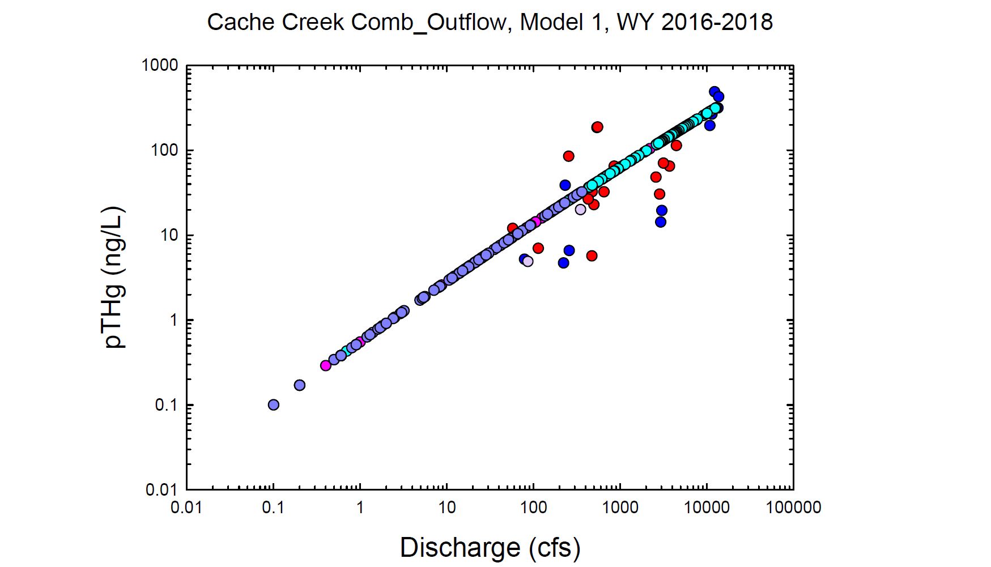
Red = Observed wy2016
Dk. Blue = Observed wy2017
Lt. Purple = Observed wy2018
Pink = Modeled wy2016
Lt. Blue = Modeled wy2017
Dk. Purple = Modeled wy2018

Slide 11
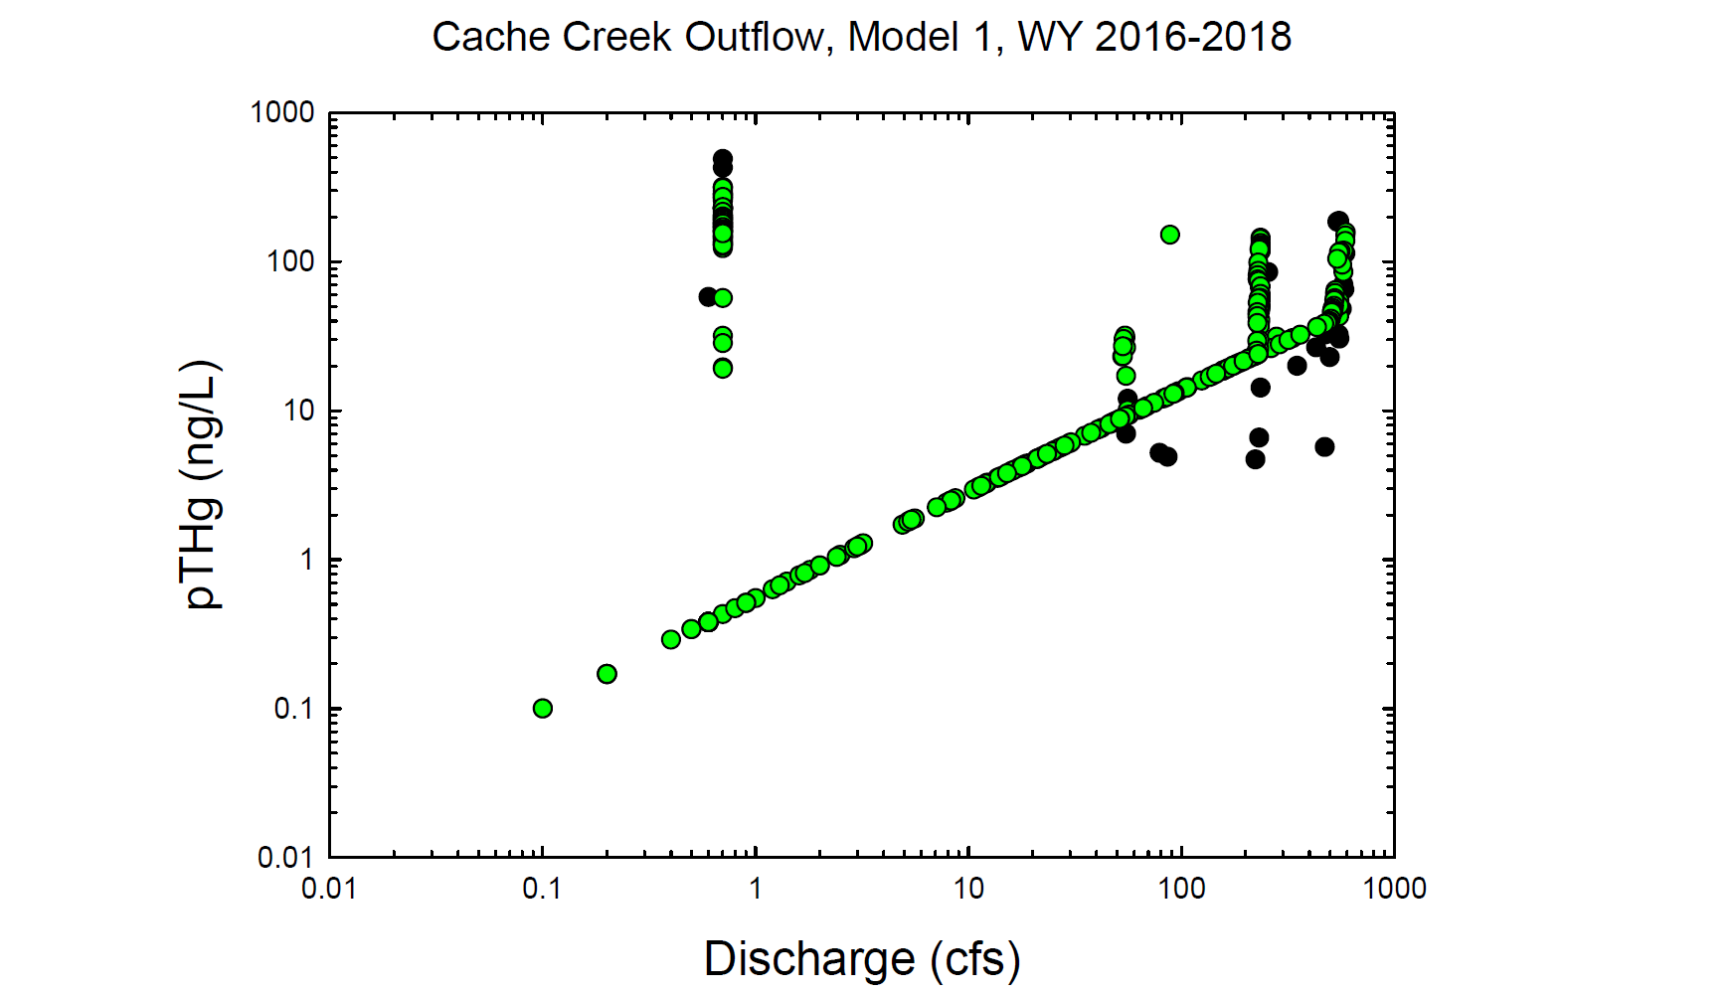
Black circles = Observed values
Green circles = Modeled values

Slide 12
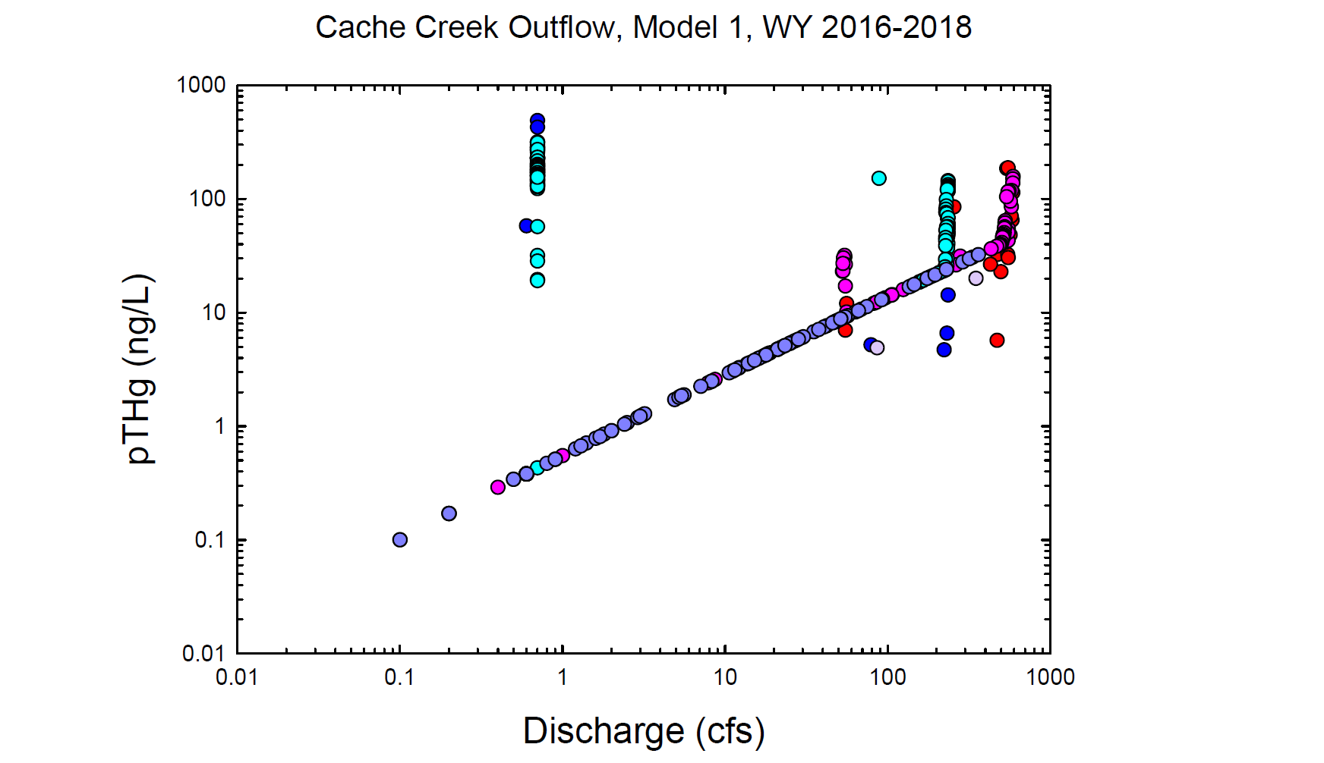
Red = Observed wy2016
Dk. Blue = Observed wy2017
Lt. Purple = Observed wy2018
Pink = Modeled wy2016
Lt. Blue = Modeled wy2017
Dk. Purple = Modeled wy2018

Slide 13
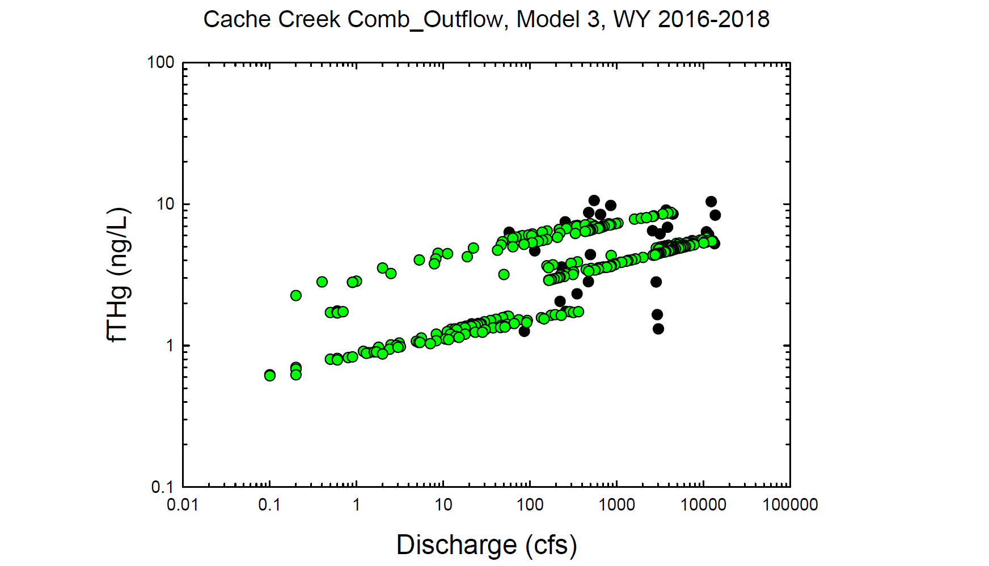
Black circles = Observed values
Green circles = Modeled values

Slide 14
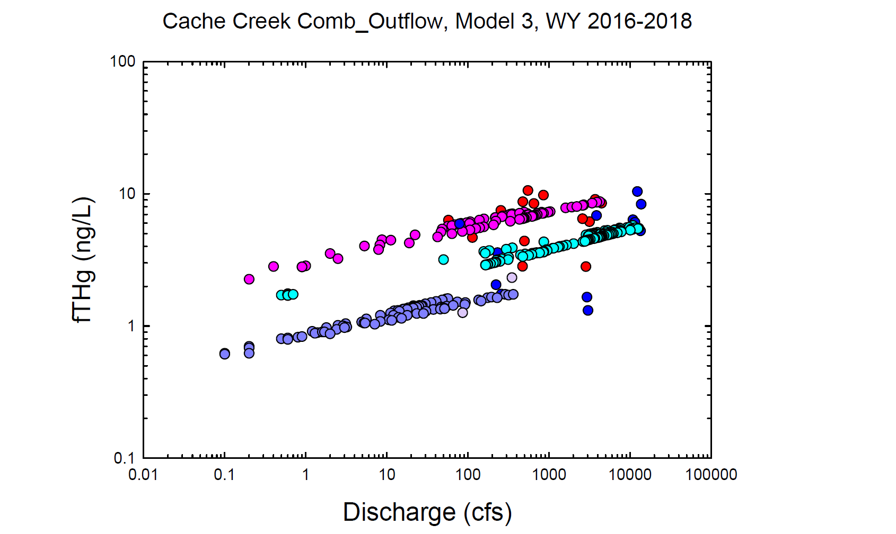
Red = Observed wy2016
Dk. Blue = Observed wy2017
Lt. Purple = Observed wy2018
Pink = Modeled wy2016
Lt. Blue = Modeled wy2017
Dk. Purple = Modeled wy2018

Slide 15
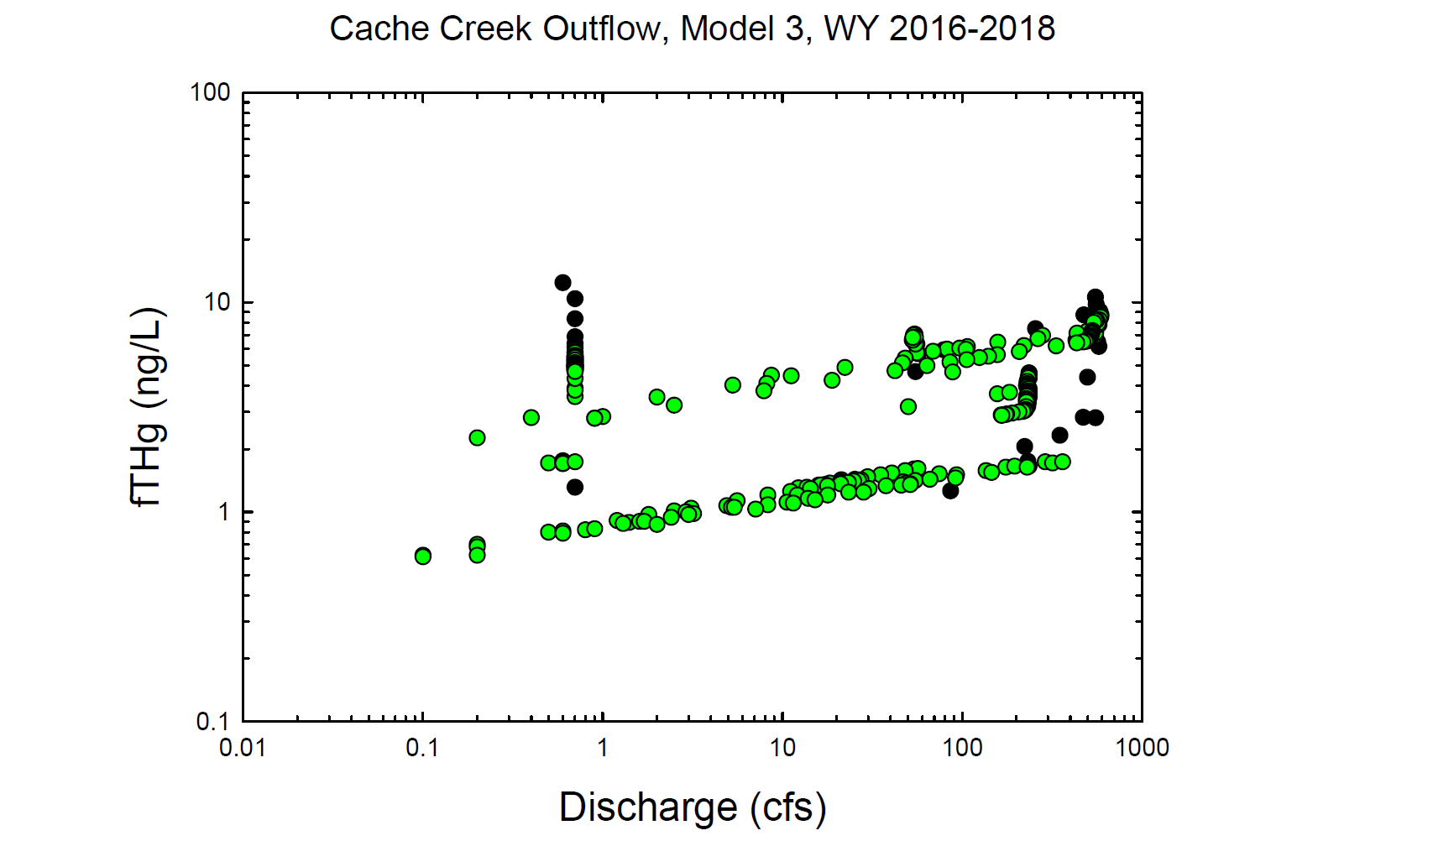
Black circles = Observed values
Green circles = Modeled values

Slide 16
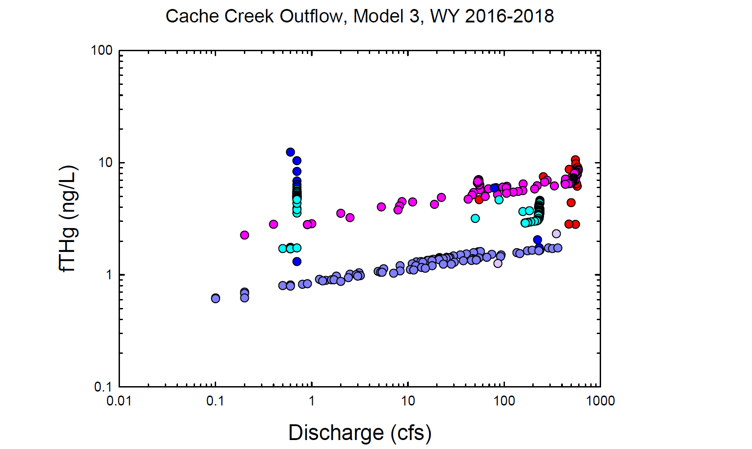
Red = Observed wy2016
Dk. Blue = Observed wy2017
Lt. Purple = Observed wy2018
Pink = Modeled wy2016
Lt. Blue = Modeled wy2017
Dk. Purple = Modeled wy2018

Slide 17
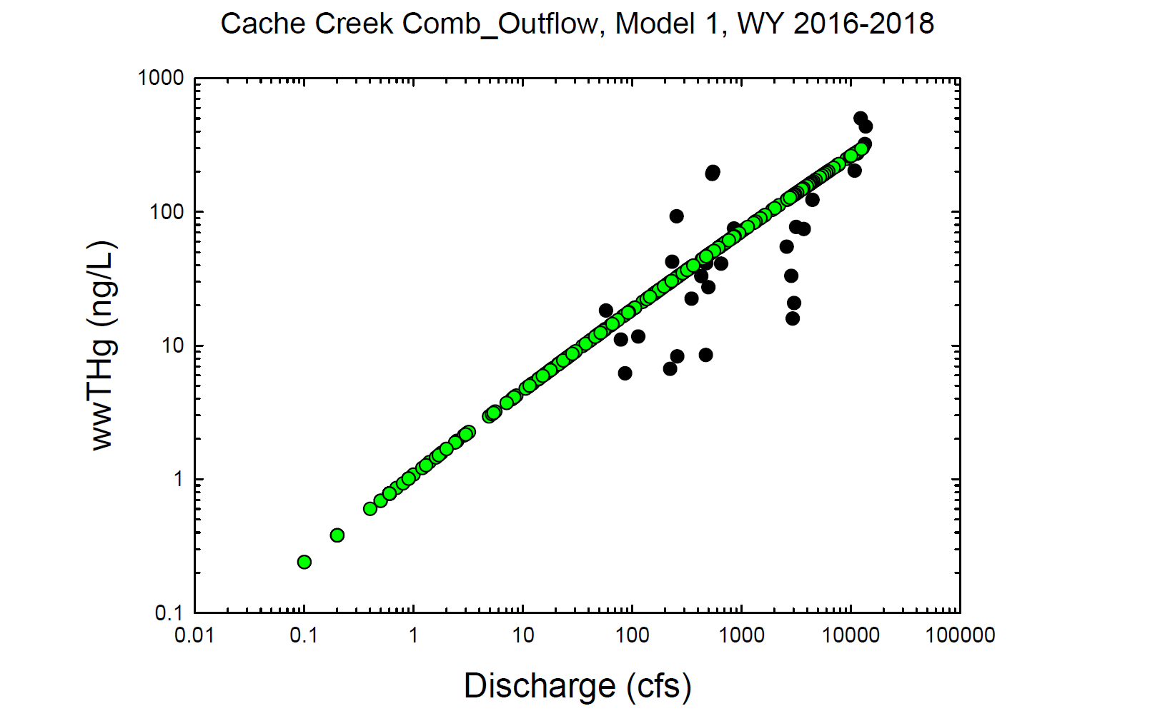
Black circles = Observed values
Green circles = Modeled values

Slide 18
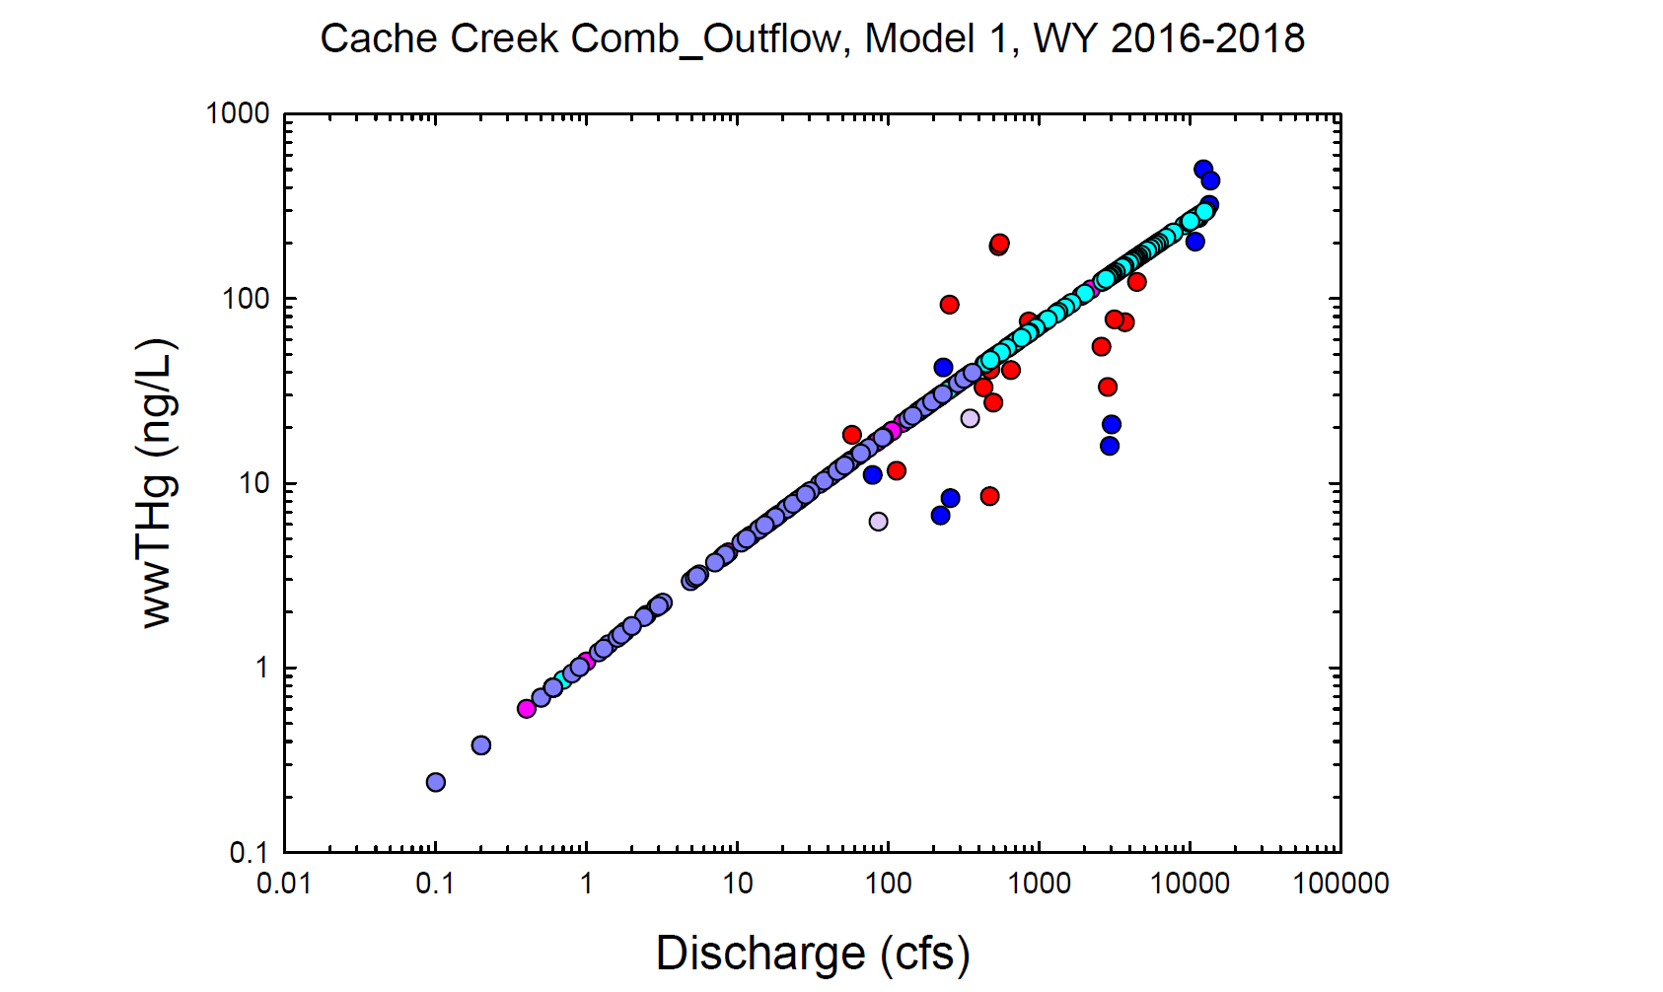
Red = Observed wy2016
Dk. Blue = Observed wy2017
Lt. Purple = Observed wy2018
Pink = Modeled wy2016
Lt. Blue = Modeled wy2017
Dk. Purple = Modeled wy2018

Slide 19
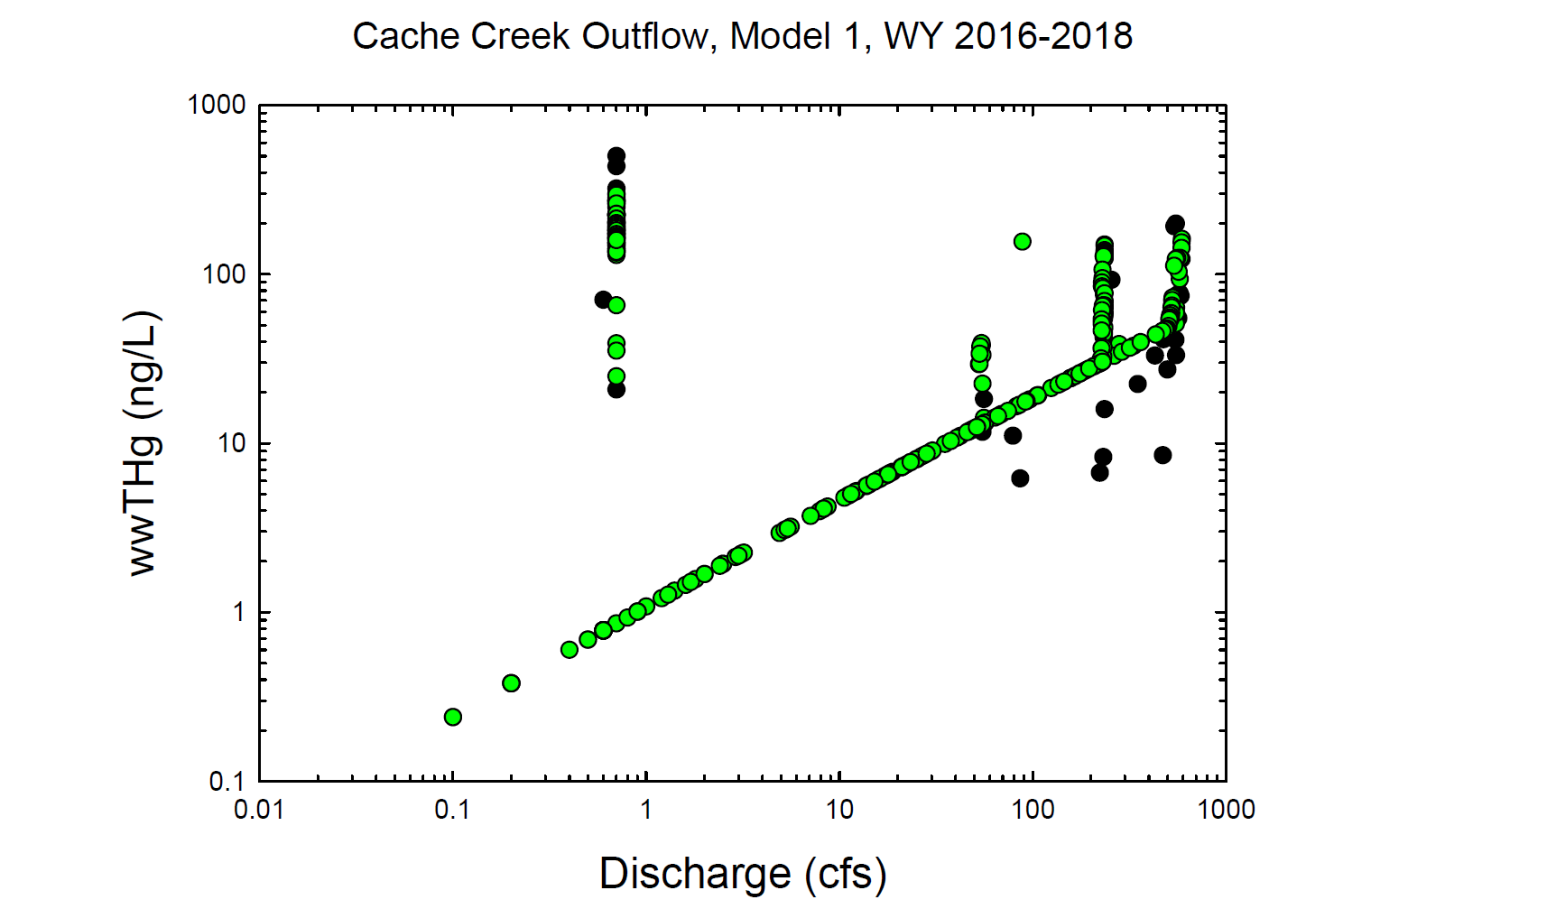
Black circles = Observed values
Green circles = Modeled values

Slide 20
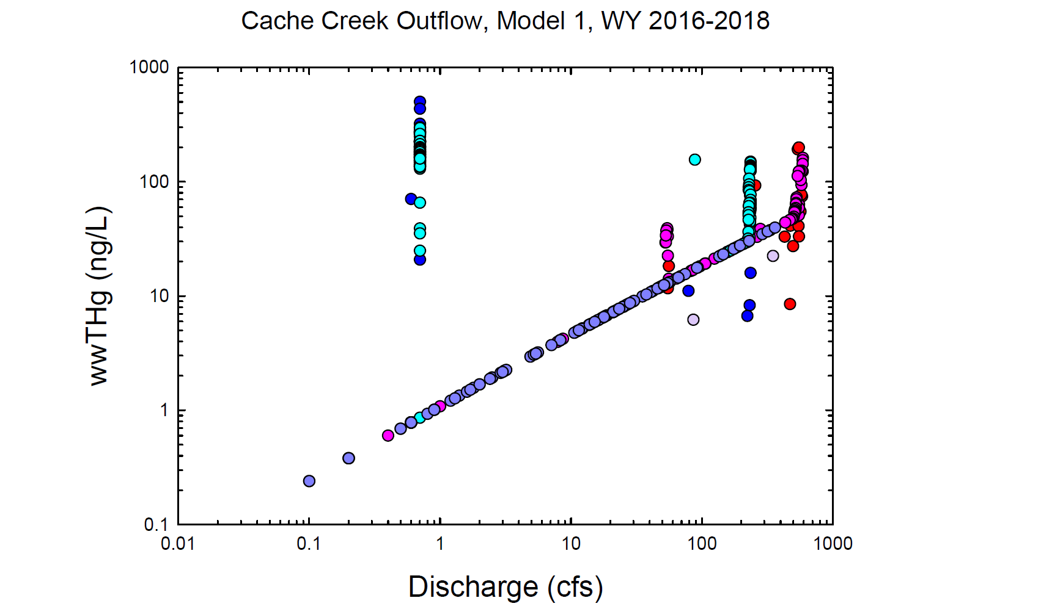
Red = Observed wy2016
Dk. Blue = Observed wy2017
Lt. Purple = Observed wy2018
Pink = Modeled wy2016
Lt. Blue = Modeled wy2017
Dk. Purple = Modeled wy2018

Slide 21
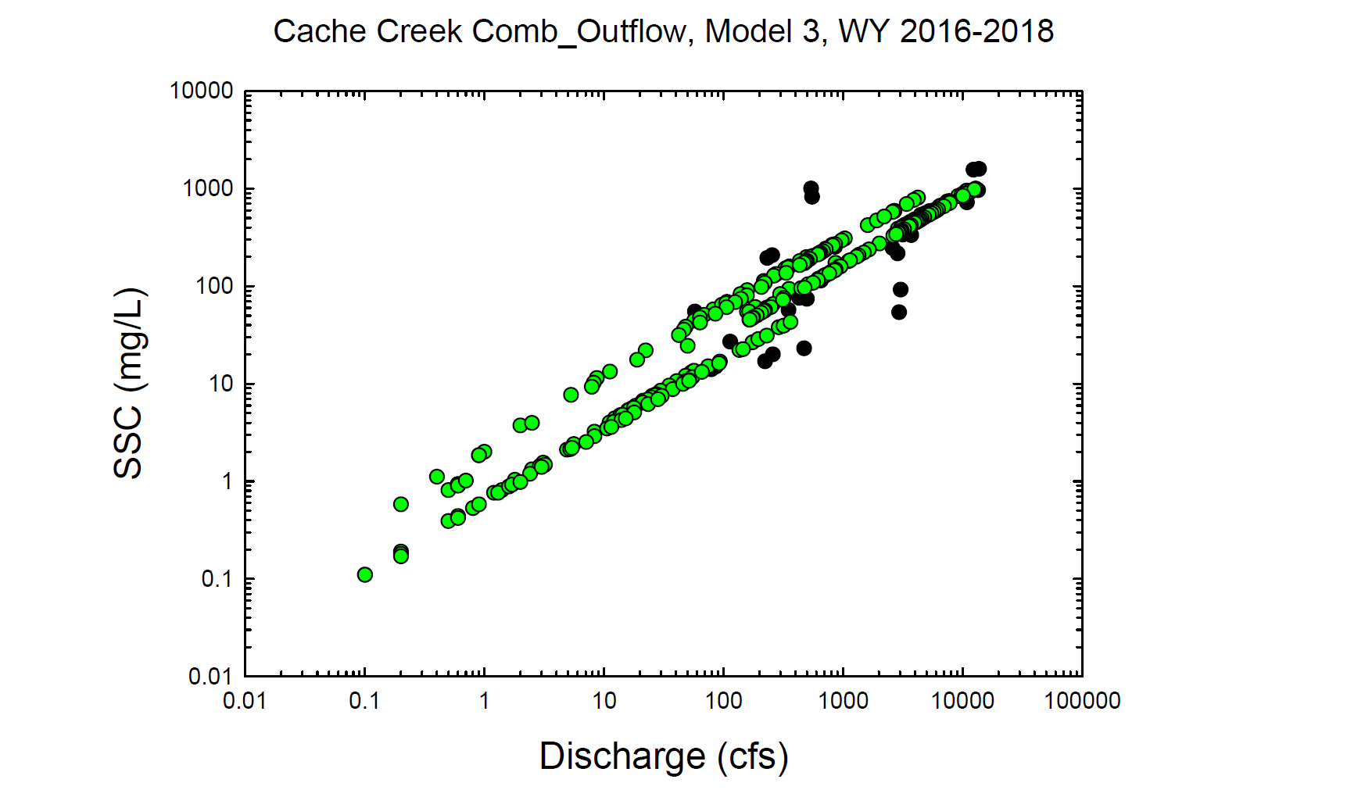
Black circles = Observed values
Green circles = Modeled values

Slide 22
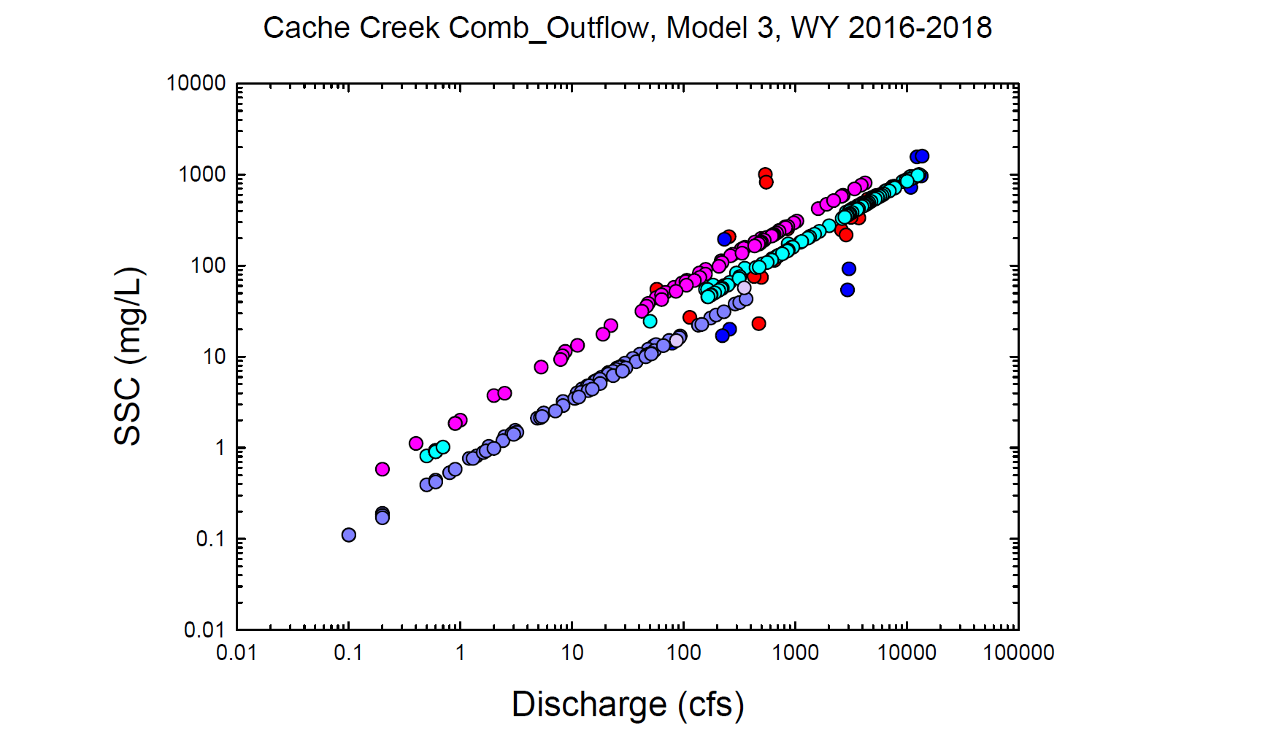
Red = Observed wy2016
Dk. Blue = Observed wy2017
Lt. Purple = Observed wy2018
Pink = Modeled wy2016
Lt. Blue = Modeled wy2017
Dk. Purple = Modeled wy2018

Slide 23
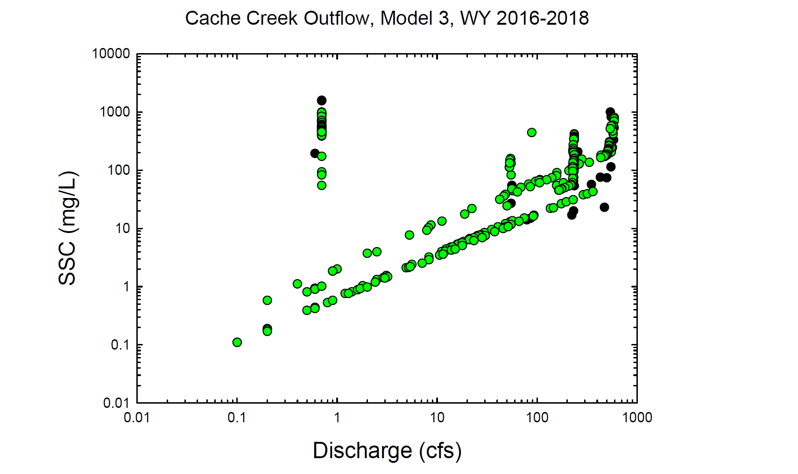
Black circles = Observed values
Green circles = Modeled values

Slide 24
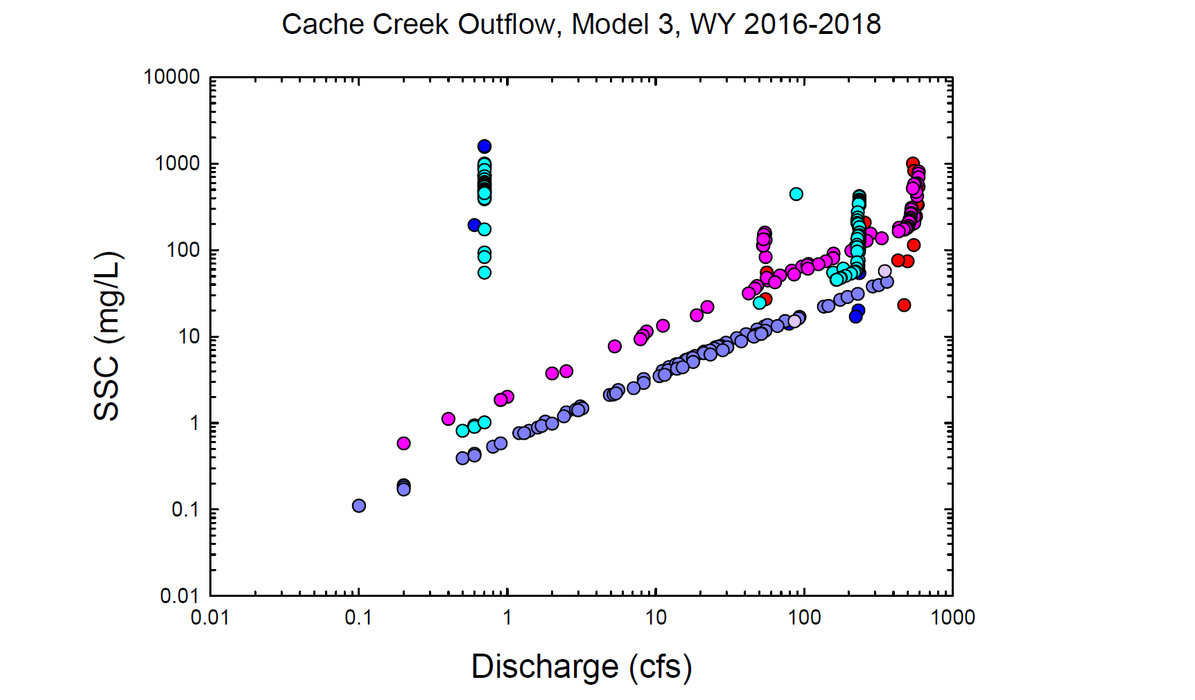
Red = Observed wy2016
Dk. Blue = Observed wy2017
Lt. Purple = Observed wy2018
Pink = Modeled wy2016
Lt. Blue = Modeled wy2017
Dk. Purple = Modeled wy2018

Slide 25
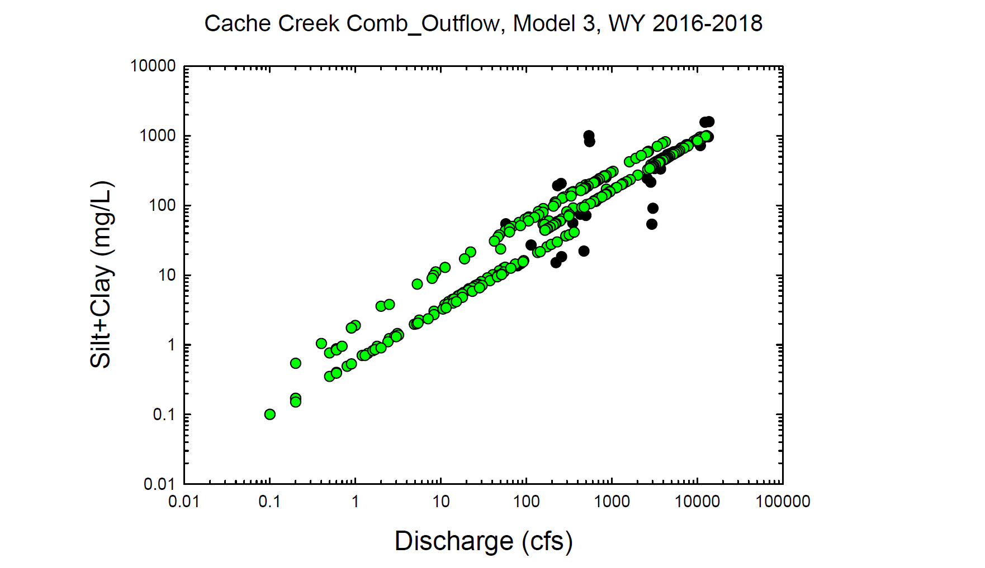
Black circles = Observed values
Green circles = Modeled values

Slide 26

Red = Observed wy2016
Dk. Blue = Observed wy2017
Lt. Purple = Observed wy2018
Pink = Modeled wy2016
Lt. Blue = Modeled wy2017
Dk. Purple = Modeled wy2018

Slide 27
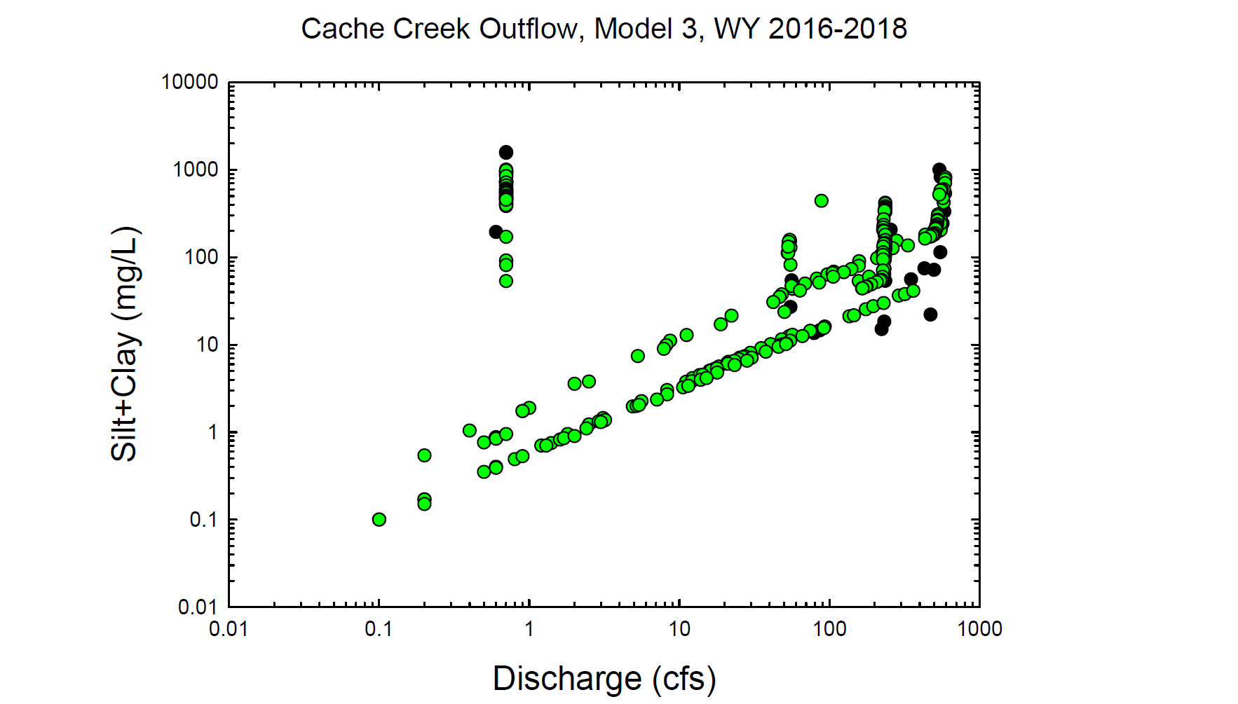
Black circles = Observed values
Green circles = Modeled values

Slide 28
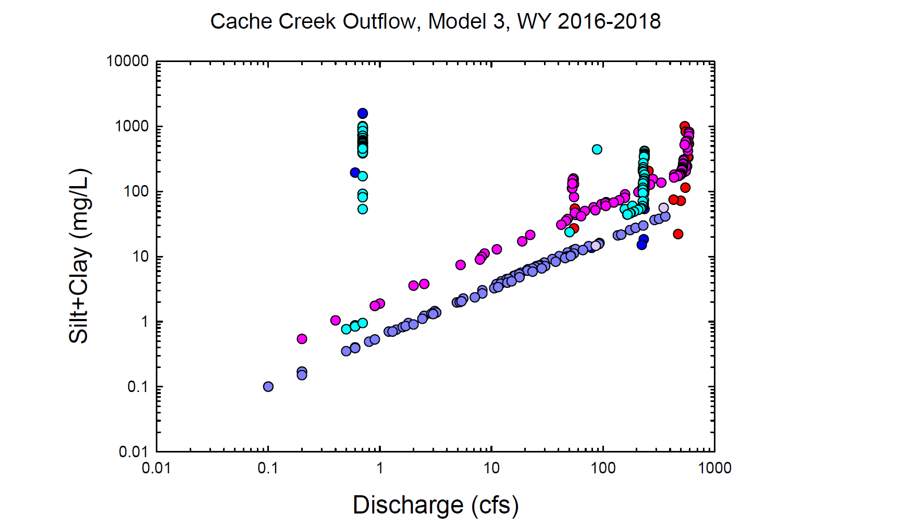
Red = Observed wy2016
Dk. Blue = Observed wy2017
Lt. Purple = Observed wy2018
Pink = Modeled wy2016
Lt. Blue = Modeled wy2017
Dk. Purple = Modeled wy2018

Slide 29
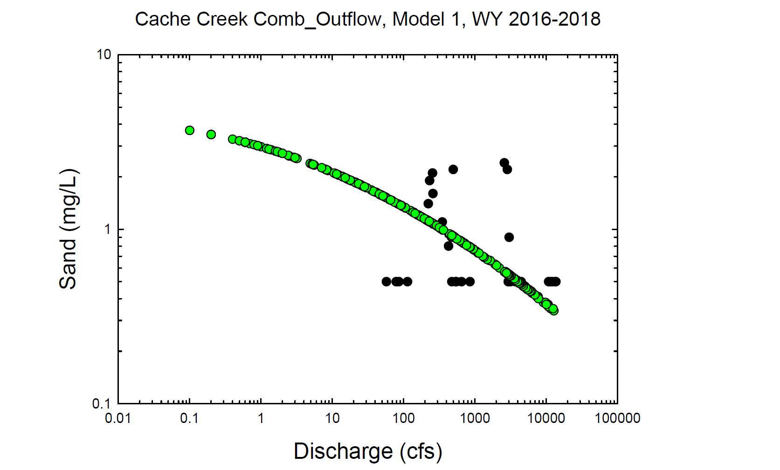
Black circles = Observed values
Green circles = Modeled values

Slide 30
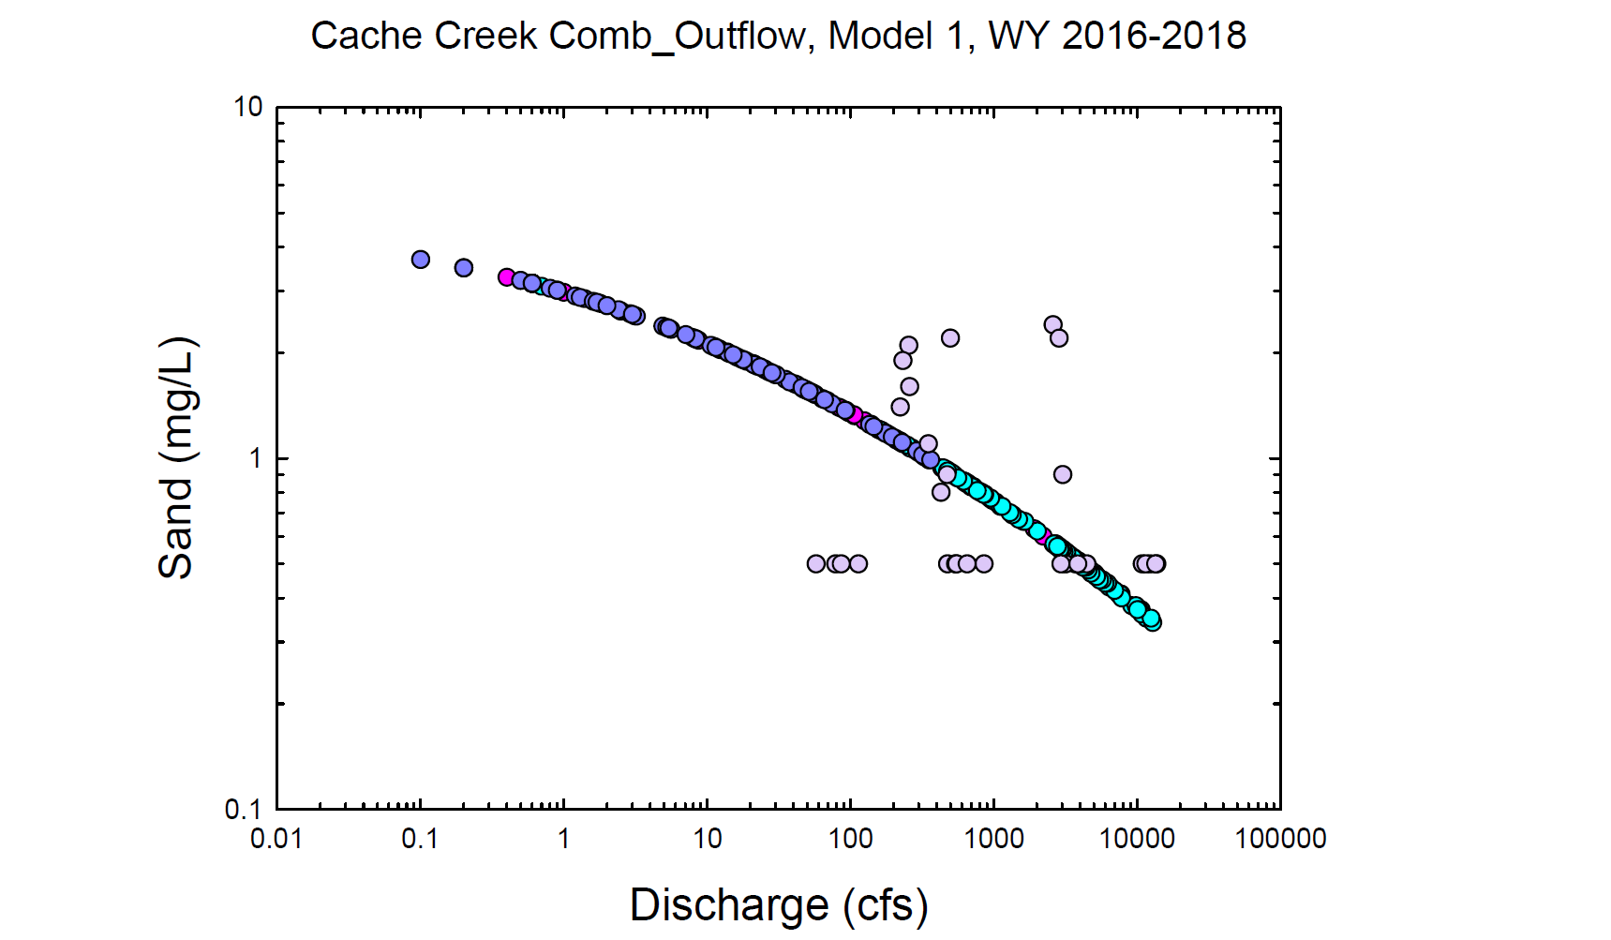
Red = Observed wy2016
Dk. Blue = Observed wy2017
Lt. Purple = Observed wy2018
Pink = Modeled wy2016
Lt. Blue = Modeled wy2017
Dk. Purple = Modeled wy2018

Slide 31
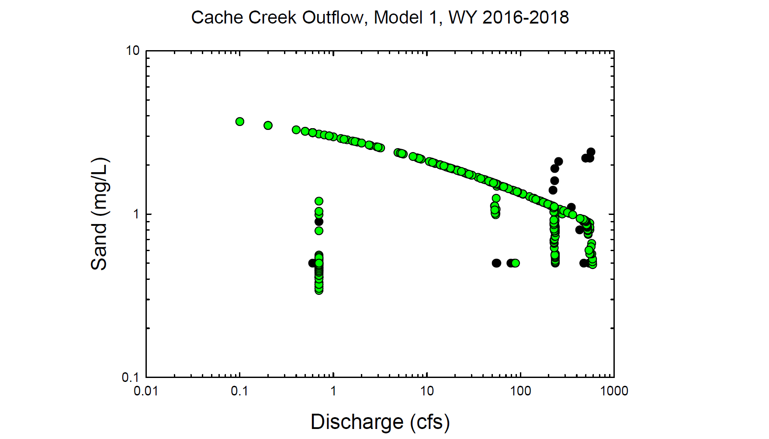
Black circles = Observed values
Green circles = Modeled values

Slide 32
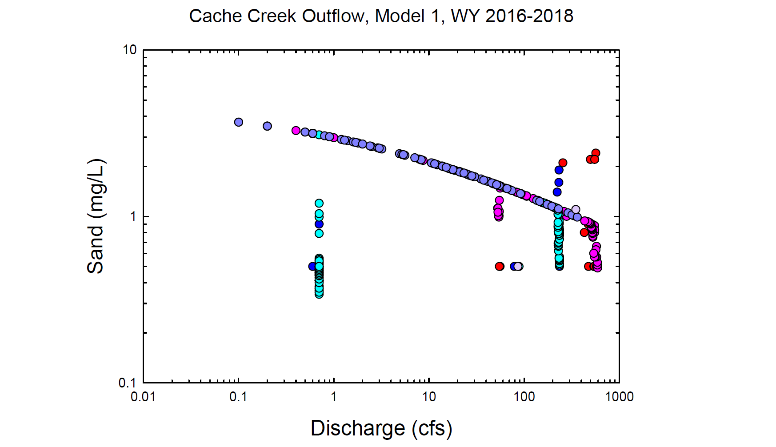
Red = Observed wy2016
Dk. Blue = Observed wy2017
Lt. Purple = Observed wy2018
Pink = Modeled wy2016
Lt. Blue = Modeled wy2017
Dk. Purple = Modeled wy2018

Slide 33
Black circles = Observed values
Green circles = Modeled values

Slide 34
Red = Observed wy2016
Dk. Blue = Observed wy2017
Lt. Purple = Observed wy2018
Pink = Modeled wy2016
Lt. Blue = Modeled wy2017
Dk. Purple = Modeled wy2018

Slide 35
Black circles = Observed values
Green circles = Modeled values

Slide 36
Red = Observed wy2016
Dk. Blue = Observed wy2017
Lt. Purple = Observed wy2018
Pink = Modeled wy2016
Lt. Blue = Modeled wy2017
Dk. Purple = Modeled wy2018

Slide 37
Black circles = Observed values
Green circles = Modeled values

Slide 38
Red = Observed wy2016
Dk. Blue = Observed wy2017
Lt. Purple = Observed wy2018
Pink = Modeled wy2016
Lt. Blue = Modeled wy2017
Dk. Purple = Modeled wy2018

Slide 39
Black circles = Observed values
Green circles = Modeled values

Slide 40
Red = Observed wy2016
Dk. Blue = Observed wy2017
Lt. Purple = Observed wy2018
Pink = Modeled wy2016
Lt. Blue = Modeled wy2017
Dk. Purple = Modeled wy2018

Slide 41
Black circles = Observed values
Green circles = Modeled values

Slide 42
Red = Observed wy2016
Dk. Blue = Observed wy2017
Lt. Purple = Observed wy2018
Pink = Modeled wy2016
Lt. Blue = Modeled wy2017
Dk. Purple = Modeled wy2018

Slide 43
Black circles = Observed values
Green circles = Modeled values

Slide 44
Red = Observed wy2016
Dk. Blue = Observed wy2017
Lt. Purple = Observed wy2018
Pink = Modeled wy2016
Lt. Blue = Modeled wy2017
Dk. Purple = Modeled wy2018

Slide 45
Black circles = Observed values
Green circles = Modeled values

Slide 46
Red = Observed wy2016
Dk. Blue = Observed wy2017
Lt. Purple = Observed wy2018
Pink = Modeled wy2016
Lt. Blue = Modeled wy2017
Dk. Purple = Modeled wy2018

Slide 47
Black circles = Observed values
Green circles = Modeled values

Slide 48
Red = Observed wy2016
Dk. Blue = Observed wy2017
Lt. Purple = Observed wy2018
Pink = Modeled wy2016
Lt. Blue = Modeled wy2017
Dk. Purple = Modeled wy2018

